Slide 1

Python
Introduction to Programming
Comp07027
Lecture 11

Slide 2
Object Oriented Programming (OOP)
In this series, you will learn OOP (Object Oriented Programming) in Python. OOP concepts include object, classes, constructor and encapsulation, polymorphism, and inheritance.

Slide 3
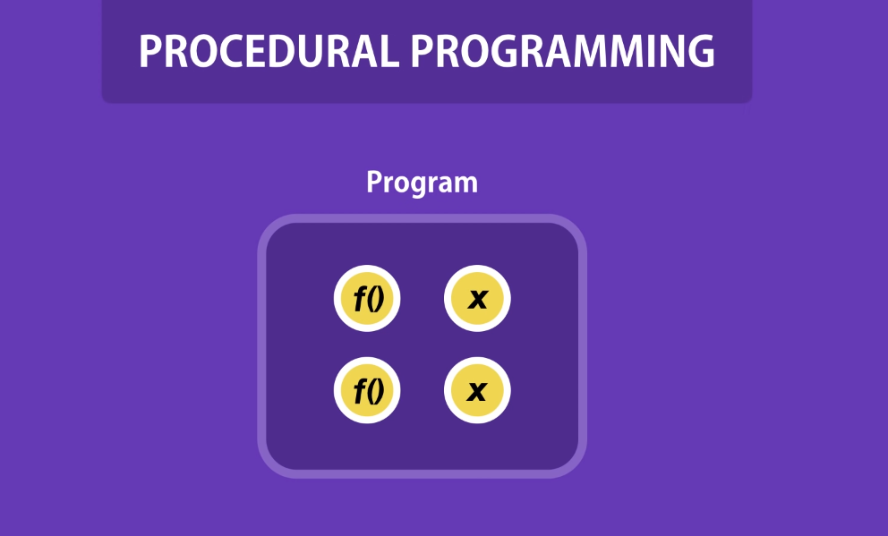
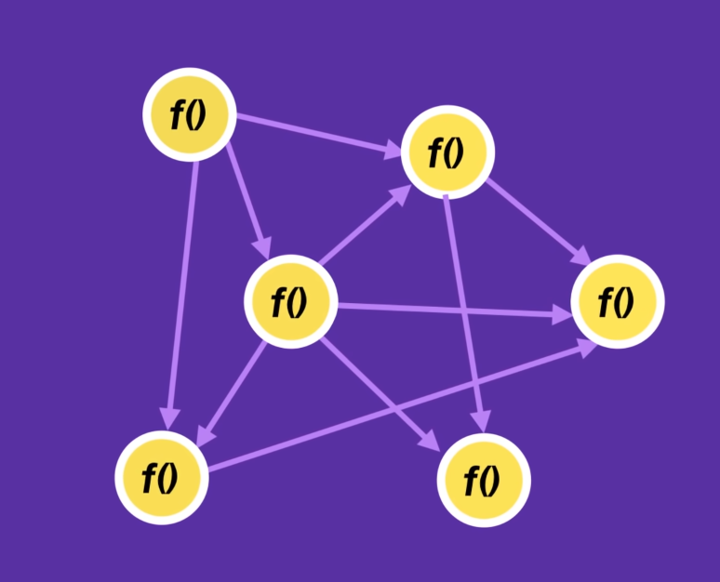
OOP
So far we have used python for structured (procedural) programming.
We have introduced how to define and use functions
However, Python can do much more!
What is class and objects in Python
Class attributes and methods
Creating and accessing object properties
Modify and delete an object

Slide 4
Objects – in the Real World
In the real world we are surrounded by objects (car, house, person)
Objects are ‘things’, they are tangible and are usually nouns
Objects in the real world have state (e.g. the car is white)
Objects in the real world also exhibit behaviours (e.g. the man is running)

Slide 5
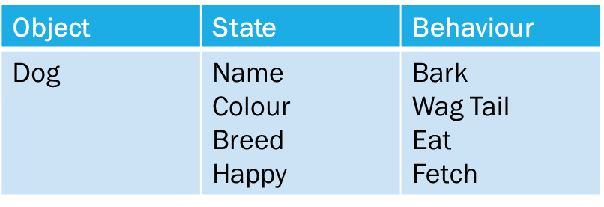
Objects – in the Real World
Look at this Dog :

Slide 6
Objects – in software
In software we can make a model of the real world.
Software objects model real world objects.
They also have state and behaviour.
Software objects have variables (attributes) which maintain the state of the object.
Software objects have methods which implement the behaviours of the object.

Slide 7
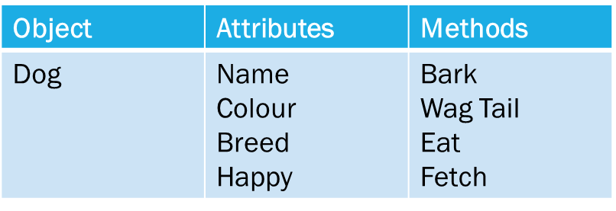
Objects – in software
Look at this Dog object:

Slide 8
Objects – in software
Software objects are not tangible but are models of tangible objects.
A software object is a model consisting of-
A set of data (attributes to maintain state)
A set of possible methods (to implement behaviours)

Slide 9
Classes
In the real world there are many millions of similar objects.
Take three dogs-
They each are dogs, but each is a distinct dog in its own right
All three dogs have the same set of characteristics (state and behaviour)
In OOP a class is a ‘blueprint’ for objects which share the same set of states and behaviours (attributes and methods)
Each object is an instance of the class – it may have a different state from other instances of the class (one dog might be happy and another not!)

Slide 10
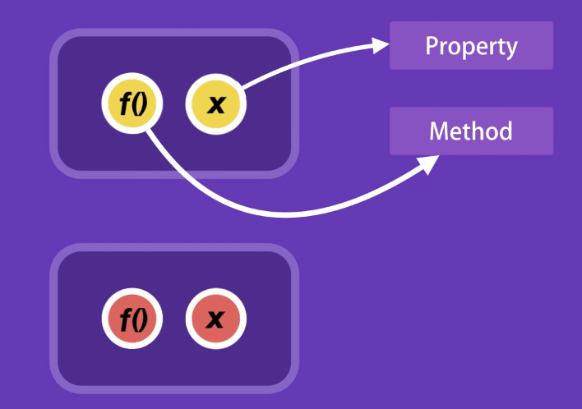
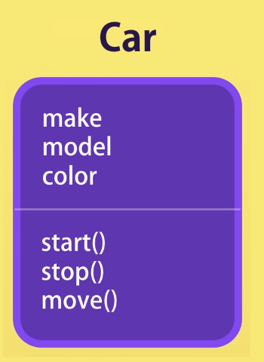
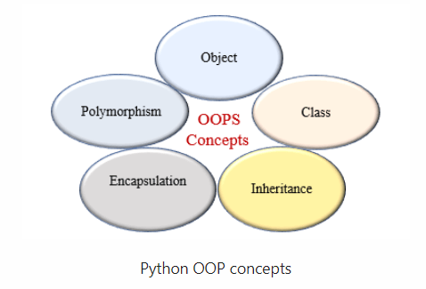
OOP Basic
Object-oriented programming (OOP) is a programming paradigm based
on the concept of "objects". The object contains both data and code: Data
in the form of properties (often known as attributes), and code,
in the form of methods (actions object can perform).
An object-oriented paradigm is to design the program
using classes and objects.

Slide 11
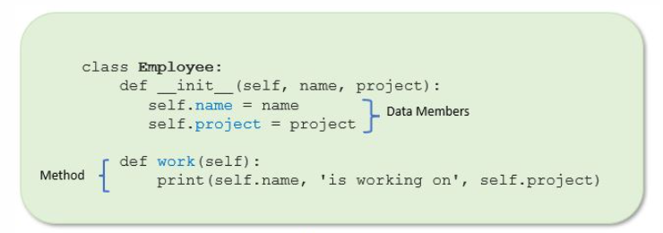
What is Encapsulation in Python?
Encapsulation in Python describes the concept of bundling data and methods within a single unit. So, for example, when you create a class, it means you are implementing encapsulation. A class is an example of encapsulation as it binds all the data members (instance variables) and methods into a single unit.

Slide 12
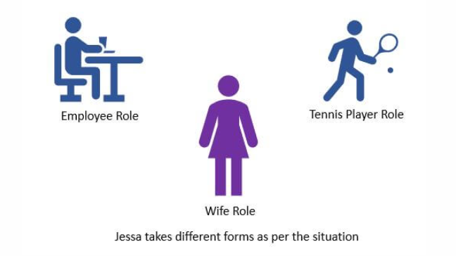
What is Polymorphism in Python?
Polymorphism in Python is the ability of an object to take many forms. In simple words, polymorphism allows us to perform the same action in many different ways.
For example, Jessa acts as an employee when she is at the office. However, when she is at home, she acts like a wife. Also, she represents herself differently in different places. Therefore, the same person takes different forms as per the situation.
In polymorphism, a method can process objects differently depending on the class type or data type.

Slide 13
What is Inheritance in Python?
The process of inheriting the properties of the parent class into a child class is called inheritance. The existing class is called a base class or parent class and the new class is called a subclass or child class or derived class.
In Object-oriented programming, inheritance is an important aspect. The main purpose of inheritance is the reusability of code because we can use the existing class to create a new class instead of creating it from scratch.

Slide 14
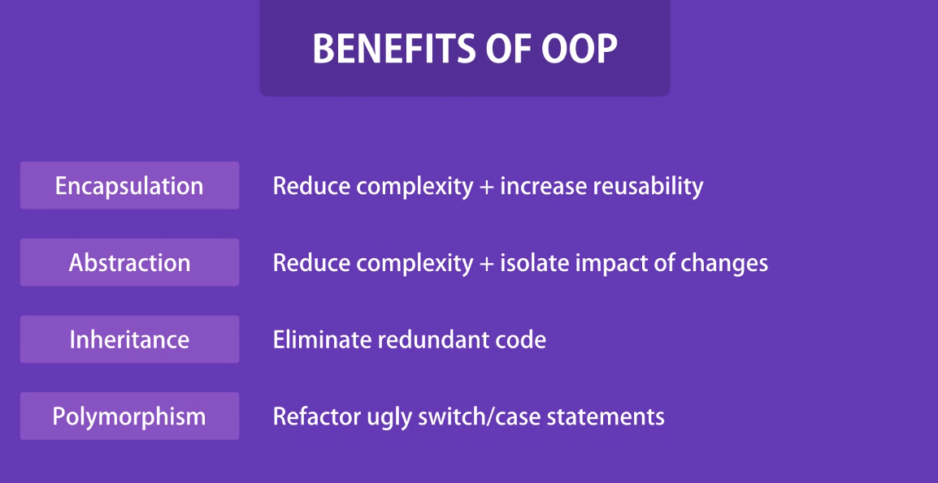
Benefits of the OOP

Slide 15
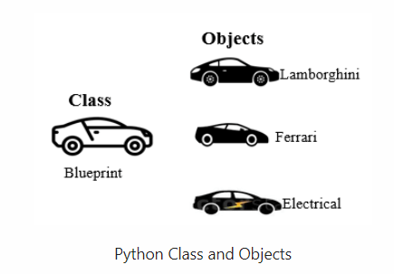
Relationship between class and object
In Python, everything is an object. A class is a blueprint for the object. To create an object, we require a model or plan or blueprint which is nothing but class.
For example, you are creating a vehicle according to the Vehicle blueprint (template). The plan contains all dimensions and structure. Based on these descriptions, we can construct a car, truck, bus, or any vehicle. Here, a car, truck, bus are objects of Vehicle class.
A class contains the properties (attribute) and action (behavior) of the object. Properties represent variables, and the methods represent actions. Hence class includes both variables and methods.
Object is an instance of a class. The physical existence of a class is nothing but an object. In other words, the object is an entity that has a state and behavior. It may be any real-world object like the mouse, keyboard, laptop, etc.

Slide 16
Class attributes and method
When we design a class, we use instance variables and class variables.
In Class, attributes can be defined into two parts:
Instance variables: The instance variables are attributes attached to an instance of a class. We define instance variables in the constructor ( the __init__() method of a class).
Class Variables: A class variable is a variable that is declared inside of class, but outside of any instance method or __init()__ method.
Inside a Class, we can define the following two major types of methods:
Instance method: Used to access or modify the object attributes. If we use instance variables inside a method, such methods are called instance methods.
Class method: Used to access or modify the class state. In method implementation, if we use only class variables, then such type of methods we should declare as a class method.

Slide 17
Creating Class and Objects
In Python, Use the keyword class to define a Class. In the class definition, the first string is docstring which, is a brief description of the class.
class classname: '''documentation string''' class_suite
Documentation string: represent a description of the class. It is optional.
class_suite: class suite contains class attributes and methods
We can create any number of objects of a class. use the following syntax to create an object of a class.
reference_variable = classname()

Slide 18
OOP Example: Creating Class and Object in Python
class Employee: # class variables company_name = 'ABC Company' # constructor to initialize the object def __init__(self, name, salary): # instance variables self.name = name self.salary = salary # instance method def show(self): print('Employee:', self.name, self.salary, self.company_name) # create first object emp1 = Employee("Harry", 12000) emp1.show() # create second object emp2 = Employee("Emma", 10000) emp2.show()
Constructors are used for initializing the objects . If you don't mention the constructor, it will use default constructor.
The self is used to represent the instance of the class. With this keyword, you can access the attributes and methods of the class in python. It binds the attributes with the given arguments.

Slide 19
Explanation of OOP Example: Creating Class and Object in Python
class Employee: # class variables company_name = 'ABC Company' # constructor to initialize the object def __init__(self, name, salary): # instance variables self.name = name self.salary = salary # instance method def show(self): print('Employee:', self.name, self.salary, self.company_name) # create first object emp1 = Employee("Harry", 12000) emp1.show() # create second object emp2 = Employee("Emma", 10000) emp2.show()
In the above example, we created a Class with the name Employee.
Next, we defined two attributes name and salary.
Next, in the __init__() method, we initialized the value of attributes. This method is called as soon as the object is created. The init method initializes the object.
Finally, from the Employee class, we created two objects, Emma and Harry.
Using the object, we can access and modify its attributes.

Slide 20
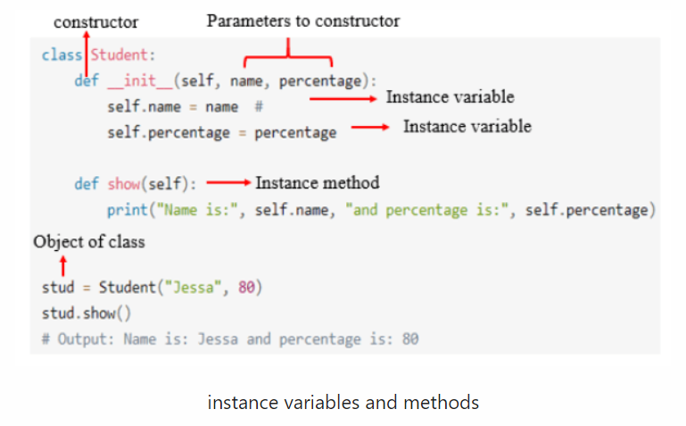

Slide 21
Constructors in Python
In Python, a constructor is a special type of method used to initialize the object of a Class. The constructor will be executed automatically when the object is created. If we create three objects, the constructor is called three times and initialize each object.
The main purpose of the constructor is to declare and initialize instance variables. It can take at least one argument that is self. The __init()__ method is called the constructor in Python. In other words, the name of the constructor should be __init__(self).
A constructor is optional, and if we do not provide any constructor, then Python provides the default constructor. Every class in Python has a constructor, but it's not required to define it.

Slide 22
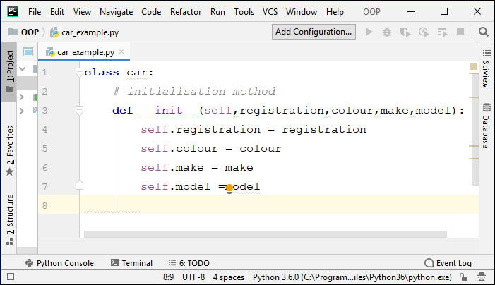
Defining a Class
We can define a Class (blueprint) for a car, with the characteristics registration number, colour, make and model.

Slide 23
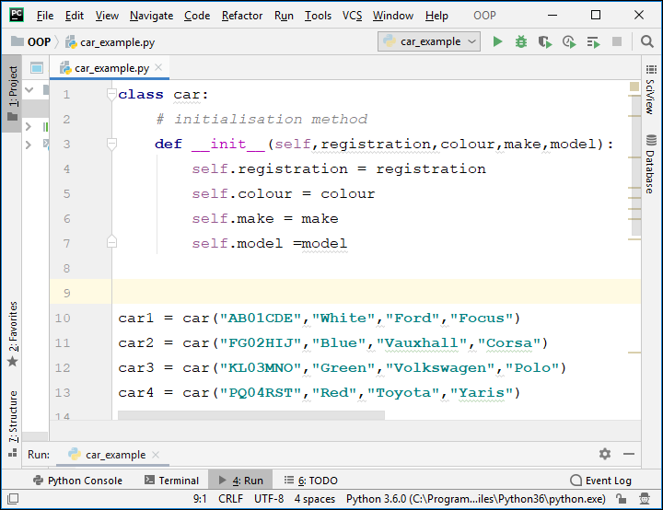

Slide 24
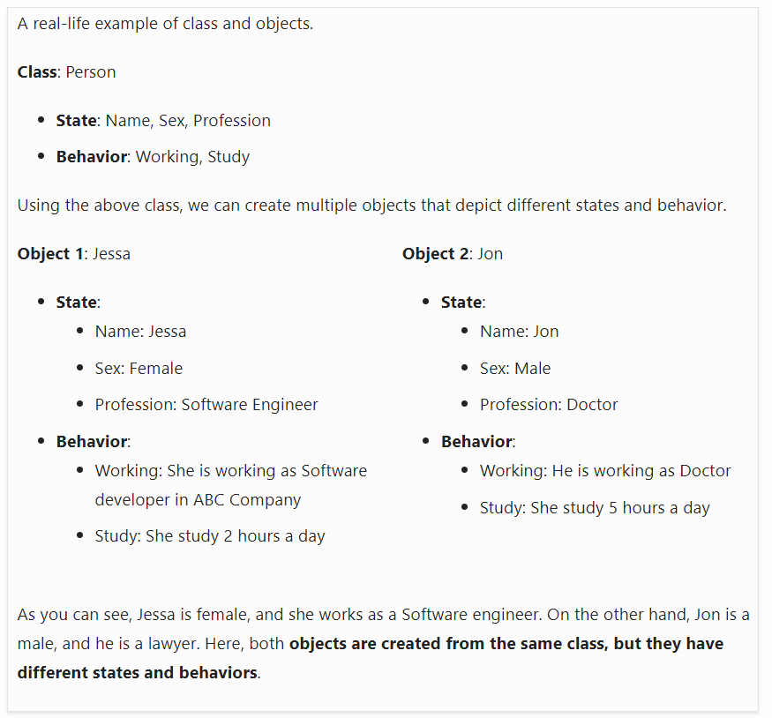
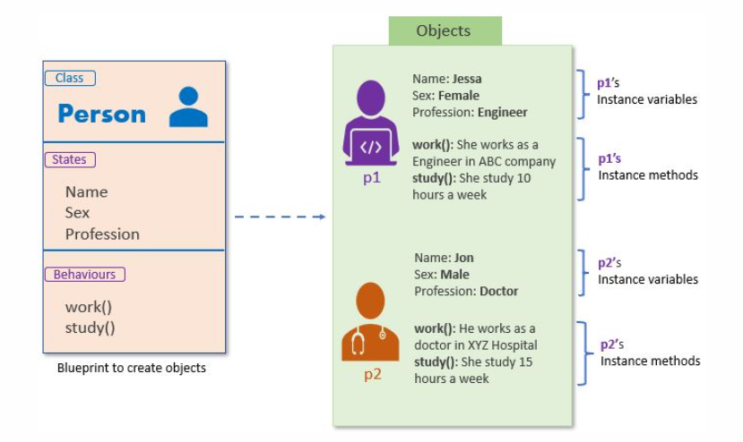

Slide 25
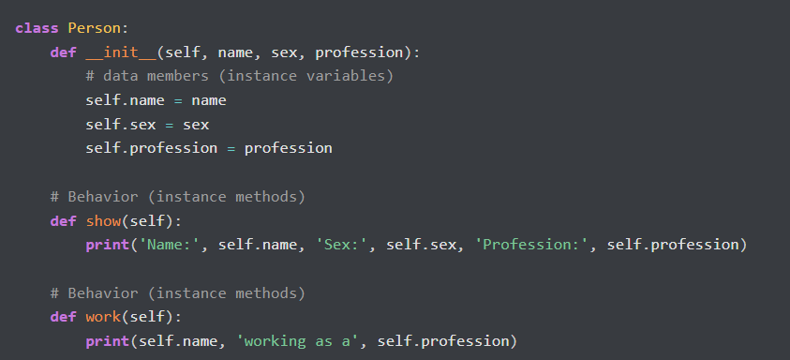
Define a class in Python

Slide 26
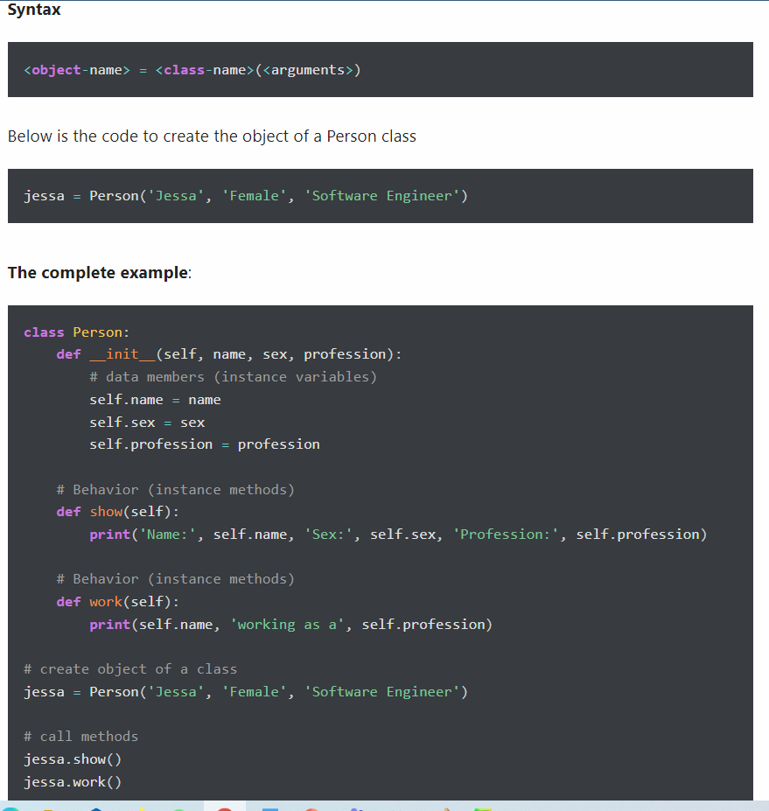
Create Object of a Class
An object is essential to work with the class attributes. The object is created using the class name. When we create an object of the class, it is called instantiation. The object is also called the instance of a class.

Slide 27
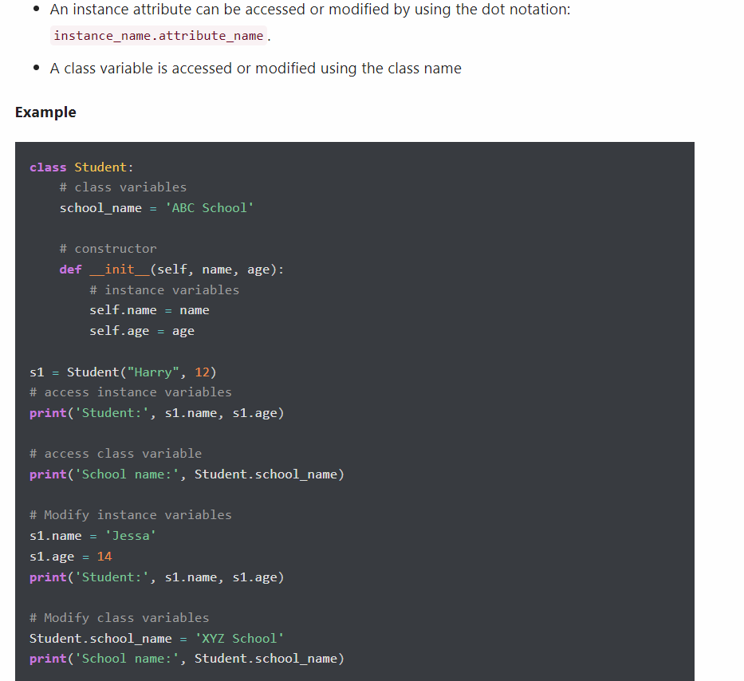
Accessing properties and assigning values

Slide 28
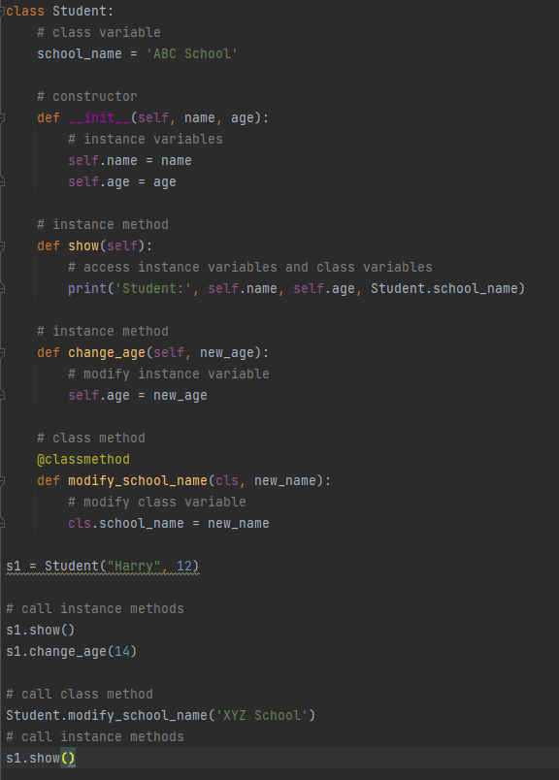
Define and call an instance method and class method

Slide 29
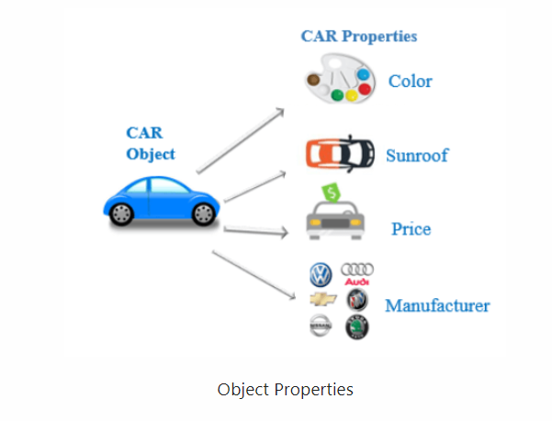
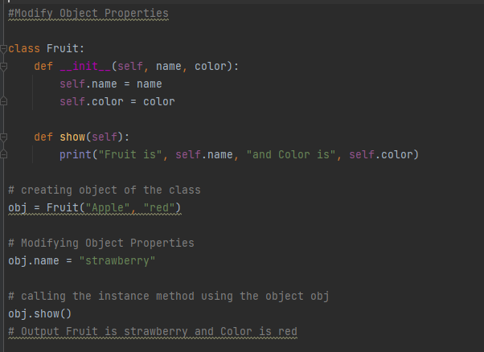
Object Properties
Every object has properties with it. In other words, we can say that object property is an association between name and value.
For example, a car is an object, and its properties are car color, sunroof, price, manufacture, model, engine, and so on. Here, color is the name and red is the value. Object properties are nothing but instance variables.
Modify Object Properties
Every object has properties associated with them. We can set or modify the object’s properties after object initialization by calling the property directly using the dot operator.

Slide 30
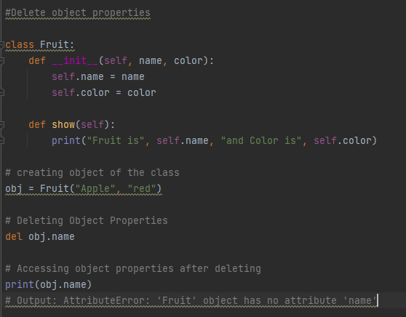
Delete object properties
We can delete the object property by using the del keyword. After deleting it, if we try to access it, we will get an error.

Slide 31
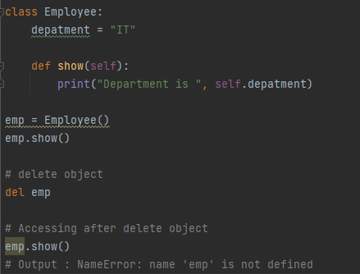
Delete Objects
In Python, we can also delete the object by using a del keyword. An object can be anything like, class object, list, tuple, set, etc.

Slide 32
Questions??

